Slide 1
Unit 8 – Software Evolution

Slide 2
Topics covered
Evolution processes
  Change processes for software systems
Program evolution dynamics
  Understanding software evolution
Software maintenance
  Making changes to operational software systems
Legacy system management
  Making decisions about software change

Slide 3
Software change
Software change is inevitable
  New requirements emerge when the software is used;
  The business environment changes;
  Errors must be repaired;
  New computers and equipment is added to the system;
  The performance or reliability of the system may have to be improved.
A key problem for all organizations is implementing and managing change to their existing software systems.

Slide 4
Importance of evolution
Organisations have huge investments in their software systems - they are critical business assets.
To maintain the value of these assets to the business, they must be changed and updated.
The majority of the software budget in large companies is devoted to changing and evolving existing software rather than developing new software.

Slide 5
Evolution processes
Software evolution processes depend on
  The type of software being maintained;
  The development processes used;
  The skills and experience of the people involved.
Proposals for change are the driver for system evolution.
  Should be linked with components that are affected by the change, thus allowing the cost and impact of the change to be estimated.
Change identification and evolution continues throughout the system lifetime.

Slide 6
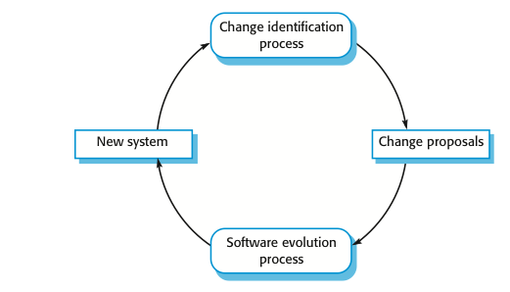

Change identification and evolution processes

Slide 7
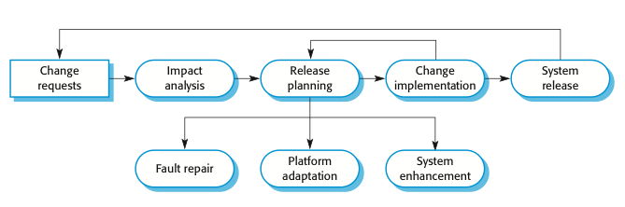
The software evolution process

Slide 8
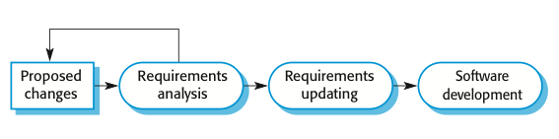
Change implementation

Slide 9
Change implementation
Iteration of the development process where the revisions to the system are designed, implemented and tested.
A critical difference is that the first stage of change implementation may involve program understanding, especially if the original system developers are not responsible for the change implementation.
During the program understanding phase, you have to understand how the program is structured, how it delivers functionality and how the proposed change might affect the program.

Slide 10
Urgent change requests
Urgent changes may have to be implemented without going through all stages of the software engineering process
  If a serious system fault has to be repaired to allow normal operation to continue;
  If changes to the system’s environment (e.g. an OS upgrade) have unexpected effects;
  If there are business changes that require a very rapid response (e.g. the release of a competing product).

Slide 11
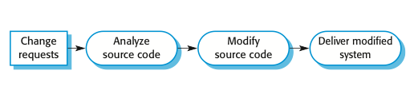
The emergency repair process

Slide 12
Agile methods and evolution
Agile methods are based on incremental development so the transition from development to evolution is a seamless one.
  Evolution is simply a continuation of the development process based on frequent system releases.
Automated regression testing is particularly valuable when changes are made to a system.
Changes may be expressed as additional user stories.

Slide 13
Program evolution dynamics
Program evolution dynamics is the study of the processes of system change.
After several major empirical studies, Lehman and Belady proposed that there were a number of ‘laws’ which applied to all systems as they evolved.
There are sensible observations rather than laws. They are applicable to large systems developed by large organisations.
  It is not clear if these are applicable to other types of software system.

Slide 14
Change is inevitable
The system requirements are likely to change
while the system is being developed because
the environment is changing. Therefore a
delivered system won't meet its requirements!
Systems are tightly coupled with their environment. When a system is installed in an
environment it changes that environment and
therefore changes the system requirements.
Systems MUST be changed if they
are to remain useful in an environment.

Slide 15
Lehman’s laws
Law | Description
Continuing change | A program that is used in a real-world environment must necessarily change, or else become progressively less useful in that environment.
Increasing complexity | As an evolving program changes, its structure tends to become more complex. Extra resources must be devoted to preserving and simplifying the structure.
Large program evolution | Program evolution is a self-regulating process. System attributes such as size, time between releases, and the number of reported errors is approximately invariant for each system release.
Organizational stability | Over a program’s lifetime, its rate of development is approximately constant and independent of the resources devoted to system development.

Slide 16
Lehman’s laws
Law | Description
Conservation of familiarity | Over the lifetime of a system, the incremental change in each release is approximately constant.
Continuing growth | The functionality offered by systems has to continually increase to maintain user satisfaction.
Declining quality | The quality of systems will decline unless they are modified to reflect changes in their operational environment.
Feedback system | Evolution processes incorporate multiagent, multiloop feedback systems and you have to treat them as feedback systems to achieve significant product improvement.

Slide 17
Applicability of Lehman’s laws
Lehman’s laws seem to be generally applicable to large, tailored systems developed by large organisations.
  Confirmed in early 2000’s by work by Lehman on the FEAST project.
It is not clear how they should be modified for
  Shrink-wrapped software products;
  Systems that incorporate a significant number of COTS components;
  Small organisations;
  Medium sized systems.

Slide 18
Key points
Software development and evolution can be thought of as an integrated, iterative process that can be represented using a spiral model.
For custom systems, the costs of software maintenance usually exceed the software development costs.
The process of software evolution is driven by requests for changes and includes change impact analysis, release planning and change implementation.
Lehman’s laws, such as the notion that change is continuous, describe a number of insights derived from long-term studies of system evolution.

Slide 19
Software maintenance
Modifying a program after it has been put into use.
The term is mostly used for changing custom software. Generic software products are said to evolve to create new versions.
Maintenance does not normally involve major changes to the system’s architecture.
Changes are implemented by modifying existing components and adding new components to the system.

Slide 20
Types of maintenance
Maintenance to repair software faults (corrective)
  Changing a system to correct deficiencies in the way meets its requirements.
Maintenance to adapt software to a different operating environment (adaptive)
  Changing a system so that it operates in a different environment (computer, OS, etc.) from its initial implementation.
Maintenance to add to or modify the system’s functionality (perfective)
  Modifying the system to satisfy new requirements.

Slide 21
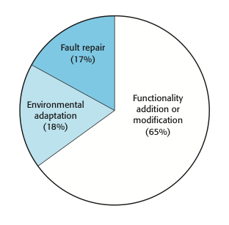
Maintenance effort distribution

Slide 22
Maintenance costs
Usually greater than development costs (2x to
30x depending on the application).
Affected by both technical and non-technical
factors.
Maintenance corrupts the software structure so
makes further maintenance more difficult.
Ageing software can have high support costs
(e.g. old languages, compilers etc.).

Slide 23
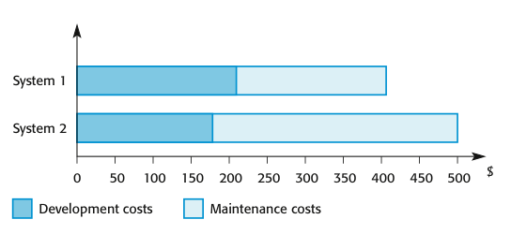
Development and maintenance costs

Slide 24
Maintenance cost factors
Team stability
  Maintenance costs are reduced if the same staff are involved with them for some time.
Contractual responsibility
  The developers of a system may have no contractual responsibility for maintenance so there is no incentive to design for future change.
Staff skills
  Maintenance staff are often inexperienced and have limited domain knowledge.
Program age and structure
  As programs age, their structure is degraded and they become harder to understand and change.

Slide 25
Maintenance prediction
Maintenance prediction is concerned with assessing which parts of the system may cause problems and have high maintenance costs
  Change acceptance depends on the maintainability of the components affected by the change;
  Implementing changes degrades the system and reduces its maintainability;
  Maintenance costs depend on the number of changes and costs of change depend on maintainability.

Slide 26
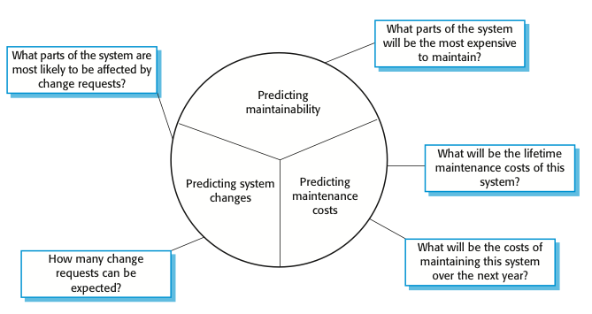
Maintenance prediction

Slide 27
System re-engineering
Re-structuring or re-writing part or all of a
legacy system without changing its
functionality.
Applicable where some but not all sub-systems
of a larger system require frequent
maintenance.
Re-engineering involves adding effort to make
them easier to maintain. The system may be re-structured and re-documented.

Slide 28
Advantages of reengineering
Reduced risk
  There is a high risk in new software development. There may be development problems, staffing problems and specification problems.
Reduced cost
  The cost of re-engineering is often significantly less than the costs of developing new software.

Slide 29
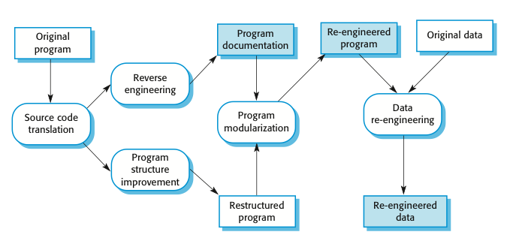
The reengineering process

Slide 30
Reengineering process activities
Source code translation
  Convert code to a new language.
Reverse engineering
  Analyse the program to understand it;
Program structure improvement
  Restructure automatically for understandability;
Program modularisation
  Reorganise the program structure;
Data reengineering
  Clean-up and restructure system data.

Slide 31
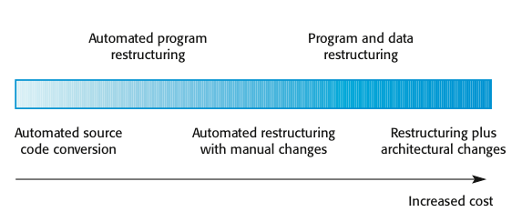
Reengineering approaches

Slide 32
Reengineering cost factors
The quality of the software to be reengineered.
The tool support available for reengineering.
The extent of the data conversion which is required.
The availability of expert staff for reengineering.
  This can be a problem with old systems based on technology that is no longer widely used.

Slide 33
Preventative maintenance by refactoring
Refactoring is the process of making improvements to a program to slow down degradation through change.
You can think of refactoring as ‘preventative maintenance’ that reduces the problems of future change.
Refactoring involves modifying a program to improve its structure, reduce its complexity or make it easier to understand.
When you refactor a program, you should not add functionality but rather concentrate on program improvement.

Slide 34
Refactoring and reengineering
Re-engineering takes place after a system has been maintained for some time and maintenance costs are increasing. You use automated tools to process and re-engineer a legacy system to create a new system that is more maintainable.
Refactoring is a continuous process of improvement throughout the development and evolution process. It is intended to avoid the structure and code degradation that increases the costs and difficulties of maintaining a system.

Slide 35
Legacy system management
Organisations that rely on legacy systems must choose a strategy for evolving these systems
  Scrap the system completely and modify business processes so that it is no longer required;
  Continue maintaining the system;
  Transform the system by re-engineering to improve its maintainability;
  Replace the system with a new system.
The strategy chosen should depend on the system quality and its business value.

Slide 36
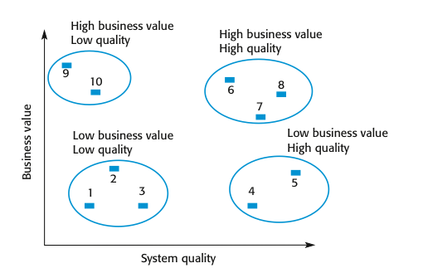
An example of a legacy system assessment

Slide 37
Legacy system categories
Low quality, low business value
  These systems should be scrapped.
Low-quality, high-business value
  These make an important business contribution but are expensive to maintain. Should be re-engineered or replaced if a suitable system is available.
High-quality, low-business value
  Replace with COTS, scrap completely or maintain.
High-quality, high business value
  Continue in operation using normal system maintenance.

Slide 38
Business value assessment
Assessment should take different viewpoints into account
  System end-users;
  Business customers;
  Line managers;
  IT managers;
  Senior managers.
Interview different stakeholders and collate results.

Slide 39
System quality assessment
Business process assessment
  How well does the business process support the current goals of the business?
Environment assessment
  How effective is the system’s environment and how expensive is it to maintain?
Application assessment
  What is the quality of the application software system?

Slide 40
Factors used in environment assessment
Factor | Questions
Supplier stability | Is the supplier still in existence? Is the supplier financially stable and likely to continue in existence? If the supplier is no longer in business, does someone else maintain the systems?
Failure rate | Does the hardware have a high rate of reported failures? Does the support software crash and force system restarts?
Age | How old is the hardware and software? The older the hardware and support software, the more obsolete it will be. It may still function correctly but there could be significant economic and business benefits to moving to a more modern system.
Performance | Is the performance of the system adequate? Do performance problems have a significant effect on system users?

Slide 41
Factors used in environment assessment
Factor | Questions
Support requirements | What local support is required by the hardware and software? If there are high costs associated with this support, it may be worth considering system replacement.
Maintenance costs | What are the costs of hardware maintenance and support software licences? Older hardware may have higher maintenance costs than modern systems. Support software may have high annual licensing costs.
Interoperability | Are there problems interfacing the system to other systems? Can compilers, for example, be used with current versions of the operating system? Is hardware emulation required?

Slide 42
Factors used in application assessment
Factor | Questions
Understandability | How difficult is it to understand the source code of the current system? How complex are the control structures that are used? Do variables have meaningful names that reflect their function?
Documentation | What system documentation is available? Is the documentation complete, consistent, and current?
Data | Is there an explicit data model for the system? To what extent is data duplicated across files? Is the data used by the system up to date and consistent?
Performance | Is the performance of the application adequate? Do performance problems have a significant effect on system users?

Slide 43
Factors used in application assessment
Factor | Questions
Programming language | Are modern compilers available for the programming language used to develop the system? Is the programming language still used for new system development?
Configuration management | Are all versions of all parts of the system managed by a configuration management system? Is there an explicit description of the versions of components that are used in the current system?
Test data | Does test data for the system exist? Is there a record of regression tests carried out when new features have been added to the system?
Personnel skills | Are there people available who have the skills to maintain the application? Are there people available who have experience with the system?

Slide 44
System measurement
You may collect quantitative data to make an assessment of the quality of the application system
  The number of system change requests;
  The number of different user interfaces used by the system;
  The volume of data used by the system.

Slide 45
Key points
There are 3 types of software maintenance, namely bug fixing, modifying software to work in a new environment, and implementing new or changed requirements.
Software re-engineering is concerned with re-structuring and re-documenting software to make it easier to understand and change.
Refactoring, making program changes that preserve functionality, is a form of preventative maintenance.
The business value of a legacy system and the quality of the application should be assessed to help decide if a system should be replaced, transformed or maintained.

Slide 46
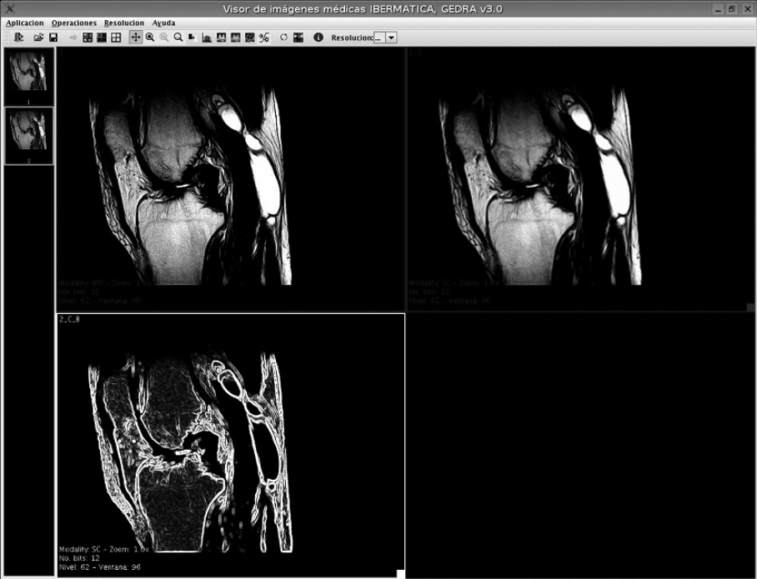
A Case Study on Software Evolution towards SOA
A case study of the evolution of an existing legacy system towards a more maintainable SOA
The analysed product is a Java-based medical imaging system, used in several Spanish hospitals. It allows visualizing several medical images at the same time and applying image transformations.

Slide 47
Objectives of evolution
Improving the usability and performance of the Product.
Improving the maintainability and interoperability of the system.

Slide 48
Architecture Recovery
The recovery process was based on QAR (QUE-es Architecture Recovery).
QAR is a generic architecture recovery workflow that follows the extract-abstract-present paradigm, and divides the extraction process into three activities (documentation analysis, static analysis and dynamic analysis).
QAR offers a process framework for architecture recovery that can be tailored to the specifics of the application domain.

Slide 49
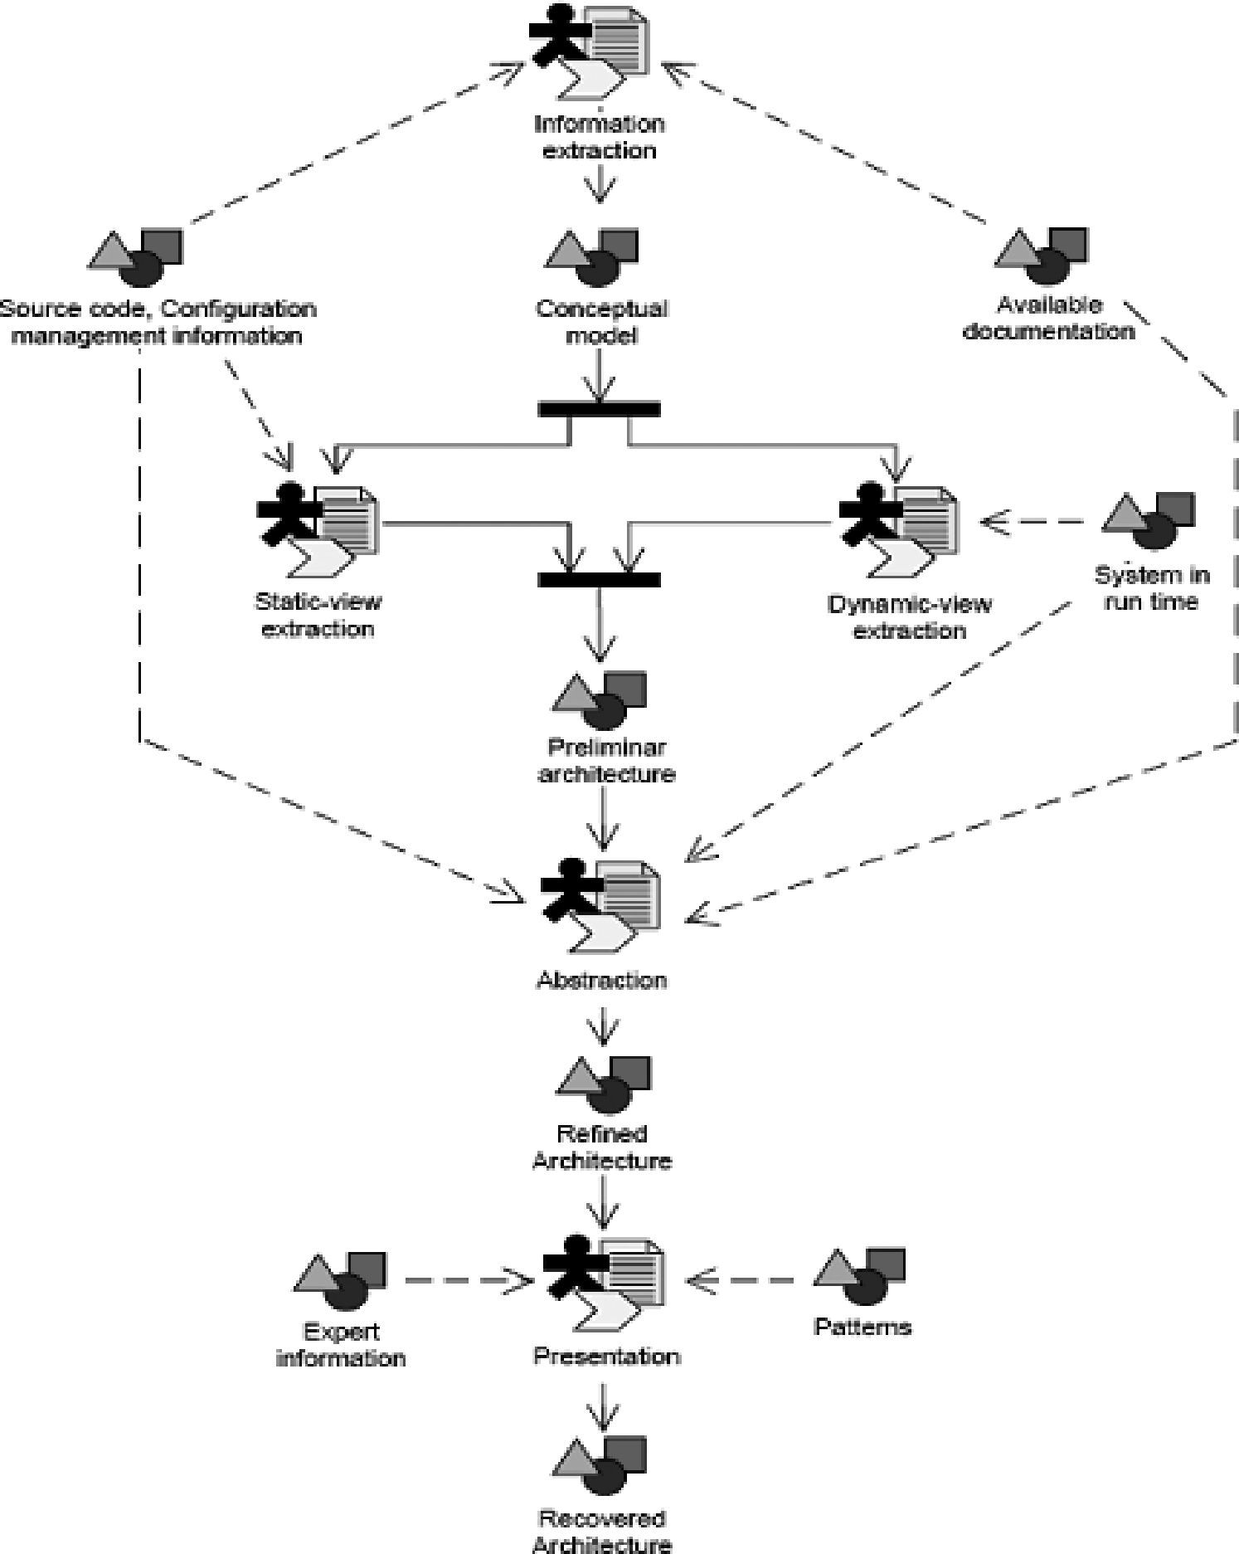
The QAR Workflow

Slide 50
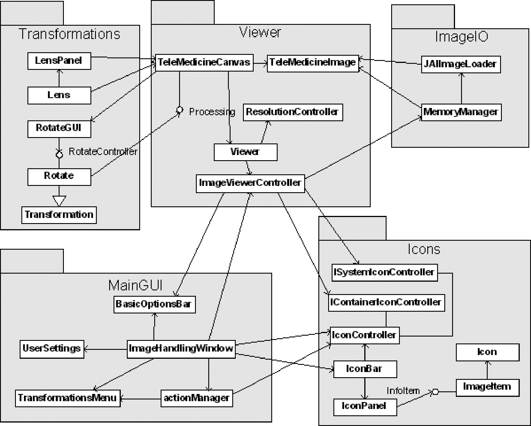
The Recovered Architecture

Slide 51
Evolution Definition
Architecture selection. Looking for a new architecture which supports an increased degree of maintainability and interoperability for the system.
Definition of the steps. With the objectives in mind, to define the required evolution cycles to achieve the desired targets.
Planning of the steps. planned a workflow for the execution of the cycles.
Feasibility check of the steps. Quick tests of the interoperability of the technologies involved in order to make a preliminary validation of the defined process.

Slide 52
Architecture selection
Maintainability and interoperability are explicitly supported by SOA.
In the Java context, the OSGi service platform provides a functional framework based on these principles.
The OSGi service platform defines a framework for service execution, plus some basic services and facilities for service lifecycle management, including a registry of services and locally available service implementations.
These characteristics have lead us to select OSGi as the enabling technology for our future architecture, which will be composed of a set of loosely coupled dynamic components integrating seamlessly via services.
Thus, moving the system architecture to the OSGi service platform is a requisite to evolve the system into a full-fledged SOA.

Slide 53
Definition of Evolution Steps
Migrate the product to the selected architecture, the OSGi Service Platform. In this case study we have chosen Eclipse Equinox (OSGi R4 implementation).
Refactor the product as a set of components interacting through services.
Develop a substitute user interface for the system, based on RCP (Rich Client Platform).
Open up the system to interoperability with PACS (Picture Archiving and Communication Systems).

Slide 54
Evolution Execution
This step consists of refactoring the legacy product into a set of loosely coupled services, deployed as bundles.
The documentation obtained from the architecture recovery process is really helpful here in order to separate the functionality of the legacy code, easing the refactoring.
The identified modules in the recovery are: graphical user interface, the image transformation component, tied to the JAI library, and the image access/storage functionality.
For each functional module we defined a generic service, with a specific implementation in the existing code base.

Slide 55
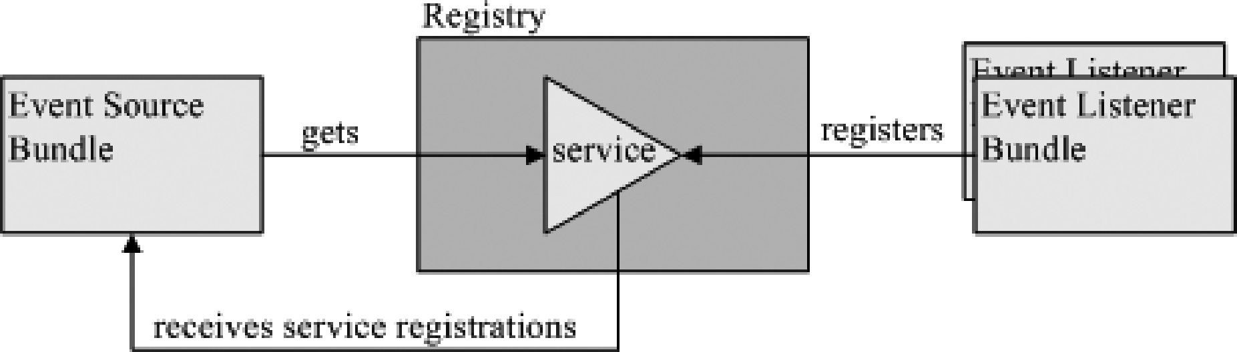
Whiteboard Actors in the OSGi Framework

Slide 56
Contact Details
Lecturer: Xiaodong Liu
Email: x.liu@napier.ac.uk
Office: C55
Phone: 455 2747

Slide 57
Reference
Ian Sommerville, Software Engineering, 10e Edition, Addison Wesley, 2017.
Ian Sommerville, Software Engineering, 10th Edition, Addison Wesley, 2015.
Félix Cuadrado, Boni García, Juan C. Dueñas, Hugo A. Parada, A Case Study on Software Evolution towards Service-Oriented Architecture, 22nd International Conference on Advanced Information Networking and Applications, Japan, 2008

